Slide 1


Raj Chhadia
13th March 2023

Slide 2

Outline
Executive Summary
Introduction
Methodology
Results
Conclusion
Appendix

Slide 3
Executive Summary
Summary of methodologies
Data Collection with API and Web-Scrapping
Data Wrangling and Analysis
Interactive Maps with Folium
Predictive Analysis for each classification model
Summary of all results
Data Analysis along with Interactive Visualizations
Best Model for Prediction

Slide 4
Introduction
Project background and context
Here we will predict if the Falcon 9 first stage will land successfully. SpaceX advertises Falcon 9 rocket launches on its website, with a cost of 62 million dollars; other providers cost upward of 165 million dollars each, much of the savings is because SpaceX can reuse the first stage.
Therefore, if we can determine if the first stage will land successfully. This information can be used if an alternate company wants to bid against SpaceX for a rocket launch.
Problems you want to find answers
With what factors, the rocket will land successfully?
The effect of each relationship of rocket variables on outcome.
Conditions which will aid SpaceX have to achieve the best results.

Slide 5

Section 1

Slide 6
Methodology
Executive Summary
Data collection methodology:
Via SpaceX REST API, Web-Scrapping from Wikipedia
Perform data wrangling
Cleaning the data by dropping irrelevant columns for better predictive analysis
Perform exploratory data analysis (EDA) using visualization and SQL
Using different SQL-Lite commands to find patterns between data. And plotted scatter and bar graphs plotted to show it.
Perform interactive visual analytics using Folium and Plotly Dash
Using Folium and Plotly Dash Visualizations
Perform predictive analysis using classification models
Build and evaluate classification models

Slide 7
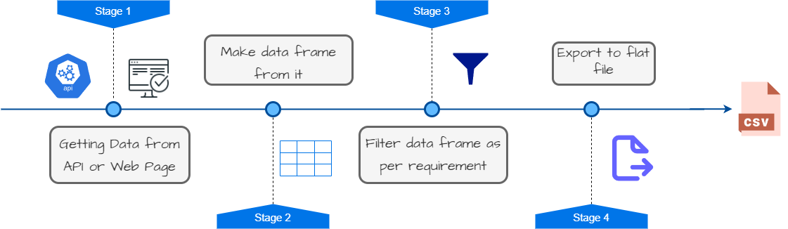
Data Collection
Data collection is the process of gathering and measuring information on targeted variables in an established system, which then enables one to answer relevant questions and evaluate outcomes.

Slide 8
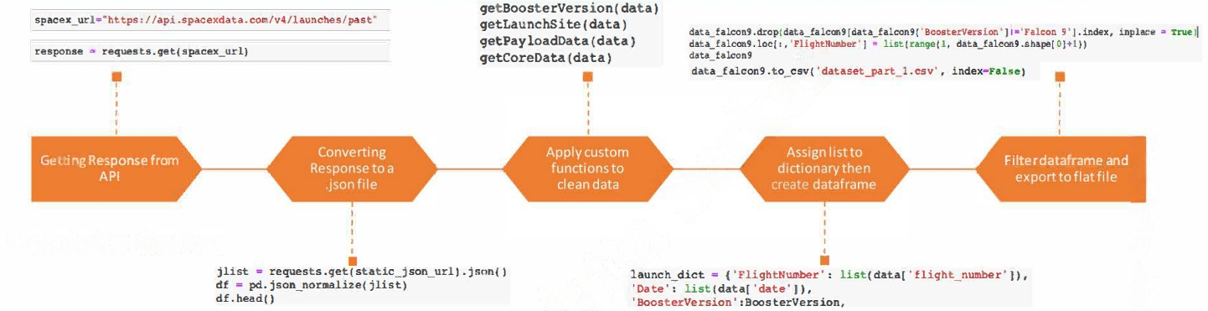
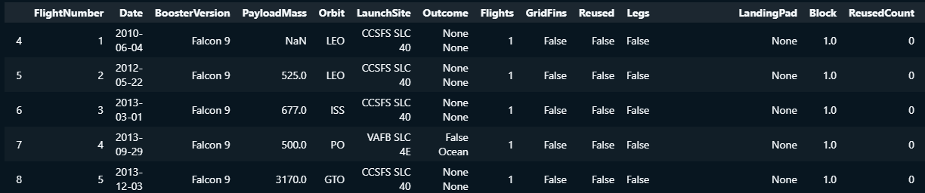
Data Collection – SpaceX API
GitHub Link

Slide 9
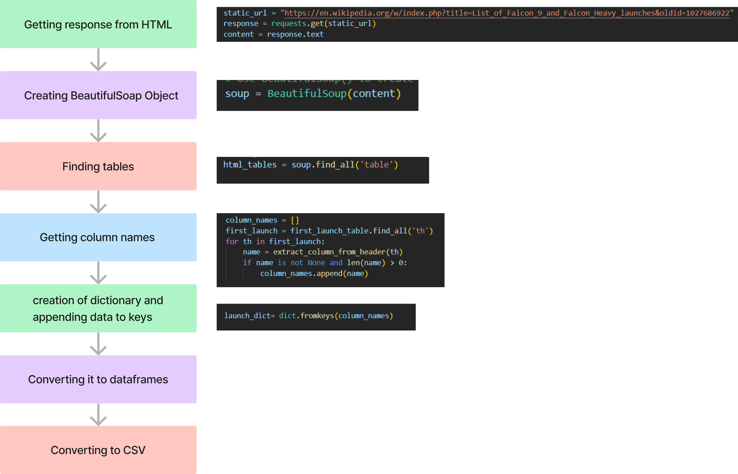
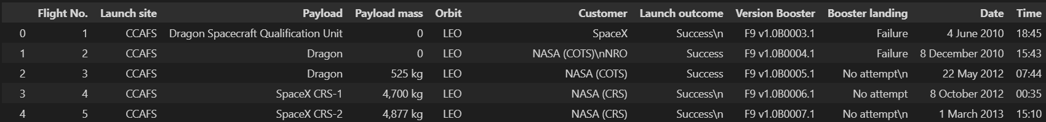
Data Collection - Scraping
GitHub link

Slide 10
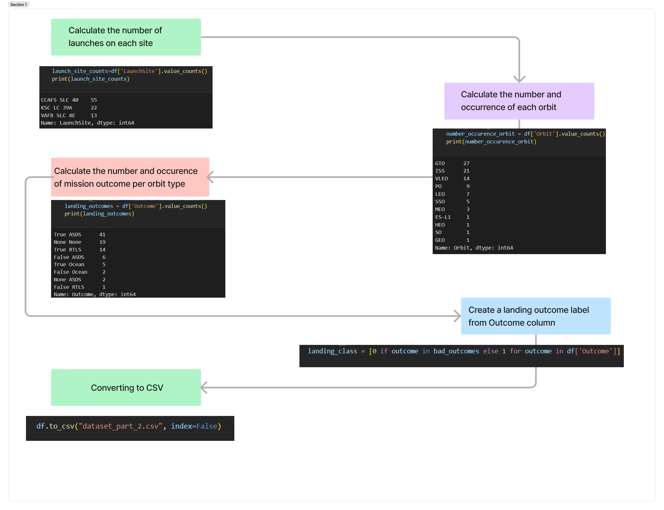
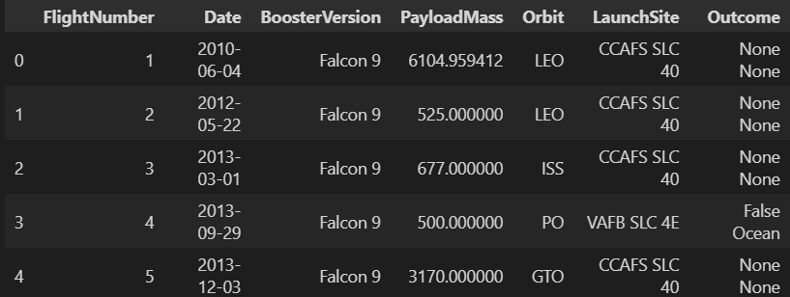

Data Wrangling
GitHub link

Slide 11

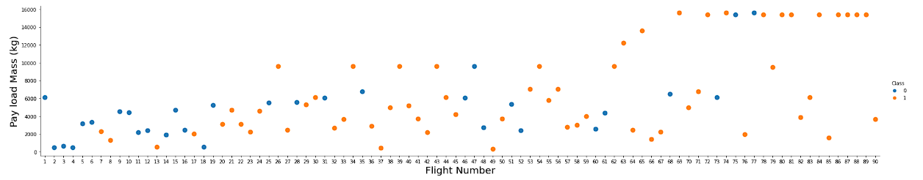
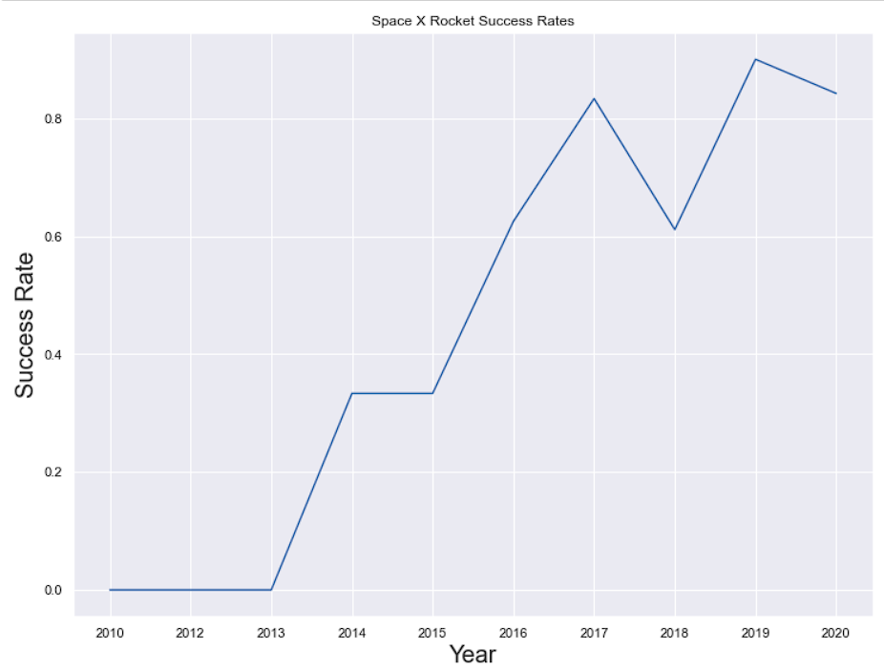
EDA with Data Visualization
Scatter Graphs plotted:
Payload mass vs Flight Number
Launch site vs Flight Number
Launch site vs Payload mass
Orbit vs Flight Number
Orbit vs Payload mass
Scatter plots can be used to spot outliers and other anomalies as well as patterns and trends in the data. They can also be used to locate clusters or groups of data or to investigate the relationship between two variables, such as whether they are positively or negatively associated.
Bar Graph:
Success rate vs orbit
GitHub link
Line Graph:
Launch Success vs year

Slide 12
EDA with SQL
We performed SQL queries to gather information from given dataset :
Displaying the names of the unique launch sites in the space mission
Display 5 records where launch sites begin with the string 'CCA'
Displaying the total payload mass carried by boosters launched by NASA (CRS)
Displaying average payload mass carried by booster version F9vl. l
Listing the date where the successful landing outcome in drone ship was achieved
Listing the names of the boosters which have success in ground pad and have payload mass greater than 4000 but less than 6000
Listing the total number of successful and failure mission outcomes
Listing the names of the booster_versions which have carried the maximum payload mass
Listing the failed landing_outcomes in drone ship, their booster versions, and launch site names for the year2015
Ranking the count of landing outcomes (such as FaiIure ( drone ship) or Success (ground pad)) between the date 2010-06-04 and 2017-03-20, in descending order.
GitHub Link

Slide 13
Build an Interactive Map with Folium
We marked all launch sites, and added map objects such as markers, circles, lines to mark the success or failure of launches for each site on the folium map.
We assigned the feature launch outcomes (failure or success) to class 0 and 1.i.e., 0 for failure, and 1 for success.
Using the color-labeled marker clusters, we identified which launch sites have relatively high success rate.
We calculated the distances between a launch site to its proximities. We answered some question for instance:
Are launch sites near railways, highways and coastlines.
Do launch sites keep certain distance away from cities.

Slide 14
Build a Dashboard with Plotly Dash
Summarize what plots/graphs and interactions you have added to a dashboard
Explain why you added those plots and interactions
Add the GitHub URL of your completed Plotly Dash lab, as an external reference and peer-review purpose

Slide 15
Predictive Analysis (Classification)
Summarize how you built, evaluated, improved, and found the best performing classification model
You need present your model development process using key phrases and flowchart
Add the GitHub URL of your completed predictive analysis lab, as an external reference and peer-review purpose

Slide 16
Results
Exploratory data analysis results
Interactive analytics demo in screenshots
Predictive analysis results

Slide 17

Section 2

Slide 18
Flight Number vs. Launch Site
Show a scatter plot of Flight Number vs. Launch Site
Show the screenshot of the scatter plot with explanations

Slide 19
Payload vs. Launch Site
Show a scatter plot of Payload vs. Launch Site
Show the screenshot of the scatter plot with explanations

Slide 20
Success Rate vs. Orbit Type
Show a bar chart for the success rate of each orbit type
Show the screenshot of the scatter plot with explanations

Slide 21
Flight Number vs. Orbit Type
Show a scatter point of Flight number vs. Orbit type
Show the screenshot of the scatter plot with explanations

Slide 22
Payload vs. Orbit Type
Show a scatter point of payload vs. orbit type
Show the screenshot of the scatter plot with explanations

Slide 23
Launch Success Yearly Trend
Show a line chart of yearly average success rate
Show the screenshot of the scatter plot with explanations

Slide 24
All Launch Site Names
Find the names of the unique launch sites
Present your query result with a short explanation here

Slide 25
Launch Site Names Begin with 'CCA'
Find 5 records where launch sites begin with `CCA`
Present your query result with a short explanation here

Slide 26
Total Payload Mass
Calculate the total payload carried by boosters from NASA
Present your query result with a short explanation here

Slide 27
Average Payload Mass by F9 v1.1
Calculate the average payload mass carried by booster version F9 v1.1
Present your query result with a short explanation here

Slide 28
First Successful Ground Landing Date
Find the dates of the first successful landing outcome on ground pad
Present your query result with a short explanation here

Slide 29
Successful Drone Ship Landing with Payload between 4000 and 6000
List the names of boosters which have successfully landed on drone ship and had payload mass greater than 4000 but less than 6000
Present your query result with a short explanation here

Slide 30
Total Number of Successful and Failure Mission Outcomes
Calculate the total number of successful and failure mission outcomes
Present your query result with a short explanation here

Slide 31
Boosters Carried Maximum Payload
List the names of the booster which have carried the maximum payload mass
Present your query result with a short explanation here

Slide 32
2015 Launch Records
List the failed landing_outcomes in drone ship, their booster versions, and launch site names for in year 2015
Present your query result with a short explanation here

Slide 33
Rank Landing Outcomes Between 2010-06-04 and 2017-03-20
Rank the count of landing outcomes (such as Failure (drone ship) or Success (ground pad)) between the date 2010-06-04 and 2017-03-20, in descending order
Present your query result with a short explanation here

Slide 34

Section 3

Slide 35
<Folium Map Screenshot 1>
Replace <Folium map screenshot 1> title with an appropriate title
Explore the generated folium map and make a proper screenshot to include all launch sites’ location markers on a global map
Explain the important elements and findings on the screenshot

Slide 36
<Folium Map Screenshot 2>
Replace <Folium map screenshot 2> title with an appropriate title
Explore the folium map and make a proper screenshot to show the color-labeled launch outcomes on the map
Explain the important elements and findings on the screenshot

Slide 37
<Folium Map Screenshot 3>
Replace <Folium map screenshot 3> title with an appropriate title
Explore the generated folium map and show the screenshot of a selected launch site to its proximities such as railway, highway, coastline, with distance calculated and displayed
Explain the important elements and findings on the screenshot

Slide 38

Section 4

Slide 39
<Dashboard Screenshot 1>
Replace <Dashboard screenshot 1> title with an appropriate title
Show the screenshot of launch success count for all sites, in a piechart
Explain the important elements and findings on the screenshot

Slide 40
<Dashboard Screenshot 2>
Replace <Dashboard screenshot 2> title with an appropriate title
Show the screenshot of the piechart for the launch site with highest launch success ratio
Explain the important elements and findings on the screenshot

Slide 41
<Dashboard Screenshot 3>
Replace <Dashboard screenshot 3> title with an appropriate title
Show screenshots of Payload vs. Launch Outcome scatter plot for all sites, with different payload selected in the range slider
Explain the important elements and findings on the screenshot, such as which payload range or booster version have the largest success rate, etc.

Slide 42

Section 5

Slide 43
Classification Accuracy
Visualize the built model accuracy for all built classification models, in a bar chart
Find which model has the highest classification accuracy

Slide 44
Confusion Matrix
Show the confusion matrix of the best performing model with an explanation

Slide 45
Conclusions
Point 1
Point 2
Point 3
Point 4
…

Slide 46
Appendix
Include any relevant assets like Python code snippets, SQL queries, charts, Notebook outputs, or data sets that you may have created during this project

Slide 47


